Slide 1

QUANTITATIVE
AUTO INSURANCE
PRICING STRATEGY
Team : Lavanda Wang, Weijian Shi, Shaoxiong Jia, Fenghe Liu, Wenyu Xu
Notes:
Hi Everyone. Welcome to our Presentation today. My name is Lavanda, we have xxx as our teammembers.
Today, we’re going to walk into Actuaries’ shoes and help our company build a quantitative auto insurance pricing strategy using the data science skills we gained from this course.

Slide 2

TABLE OF CONTENTS
01
02
03
Project Overview
Exploratory Data Analysis
Pricing Strategy - Coverage Classification
04
05
06
Pricing Strategy - Lifetime Value
Pricing Strategy - Monthly Premium
Conclusion and Future Perspectives
The problems we’re trying to solve and how we approach to them
Explore the main characteristics of our data and the relationship between our target and features
We employ classification tools to classify customers into different insurance coverage plans
We employ machine learning models to train and test data that help us predict customer lifetime value
We employ machine learning models to train and test data that help us predict monthly auto premium
Next steps we are open to take in the future
Notes:
We’ll break down the presentation into 6 sections. First a project overview, and then the EDA we did, along with some visuals. Then we’ll move on to our pricing strategy and the three models we built, and finally a conclusion and future perspectives.

Slide 3

Project OVERVIEW
01

Slide 4

PROBLEM
SOLUTION
As auto insurance actuaries, we stay open to applying cutting-edge tools in our pricing strategies.
How can we employ machine learning tools to construct a quantitative pricing strategy?
Step 1: Collect customer data
Step 2: Analyze the data and explore feature characteristics
Step 3: Build a model to classify coverage plans
Step 4: Build a model to predict each customer’s lifetime value
Step 5: Build a model to calculate the customer’s monthly auto premium
Notes:
In this project, the problem is: as auto insurance actuaries, how can we employ cutting-edge data tools into our pricing strategy. Our team have come up with a 5 step solution starting with collecting customer data, and then analyze customer feature characteristics, and then classify our customers into different coverage plans applying classification modeling. And then predict the each customer’s lifetime value with machine learning modeling, and finally construct a pricing model to compute the appropriate monthly premium for each customer.

Slide 5
Categorical Features
Numerical Features
State Abbreviations
State
Response
Coverage
Education
Effective To Date
Employment Status
Gender
Location Code
Marital Status
Policy Type
Policy
Renew Offer Type
Sales Channel
Vehicle Class
Vehicle Size
Accident Severity in State
Number of Accidents in State
Customer Lifetime Value
Income
Monthly Premium Auto
Months Since Last Claim
Months Since Policy Inception
Number of Open Complaints
Number of Policies
Total Claim Amount
Notes:
Let’s start with the dataset. It has more than 9000 rows and 26 features. It has a bunch of categorical features as well as numerical features. The three highlighted features here are the target variables we’re trying to model.

Slide 6


Targets
Coverage
Customer Lifetime Value
Monthly Auto Premium
Basic
Extended
Premium
The total amount of money a customer is expected to spend with our insurance products, during the lifetime of our business relationships
The amount of money we are supposed to charge customers every month
Notes:
Under coverage plans, we have basic, extended, and premium.
Customer lifetime value means the total amount of money a customer is expected to spend with our insurance products during the lifetime of business relationships.
Finally, the monthly auto premium is the amount of money our customers pay to us every month.

Slide 7

02
Exploratory
Data Analysis
Notes:
Gaining a broad understanding of our dataset, let’s move onto EDA

Slide 8
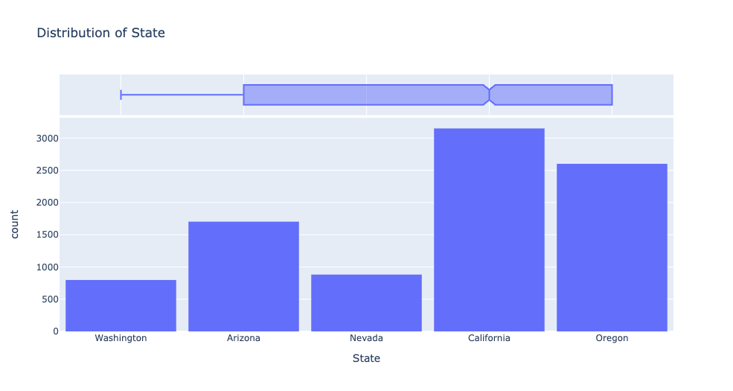
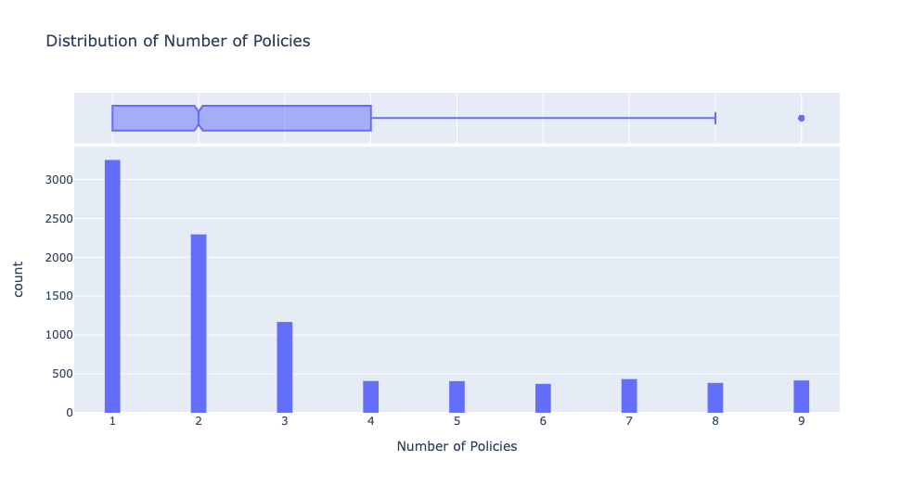
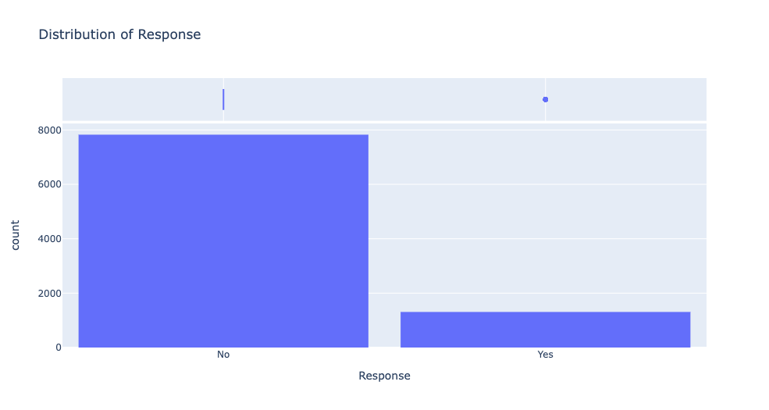
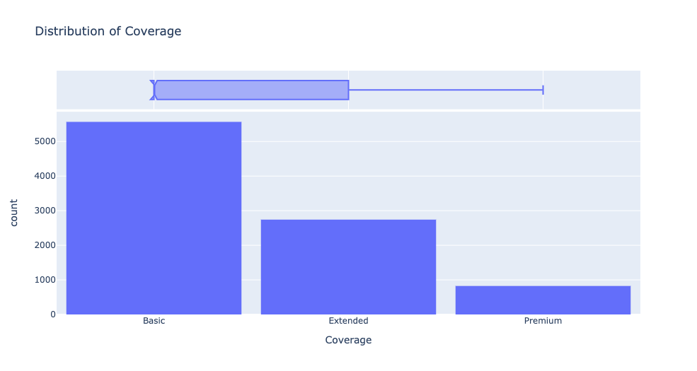
Distributions of Features
Notes:
Firstly, we decided to analyze the distributions of our features in order to get to know more about the dataset as well as build more intuition of how our insurance customers distributed.

Slide 9
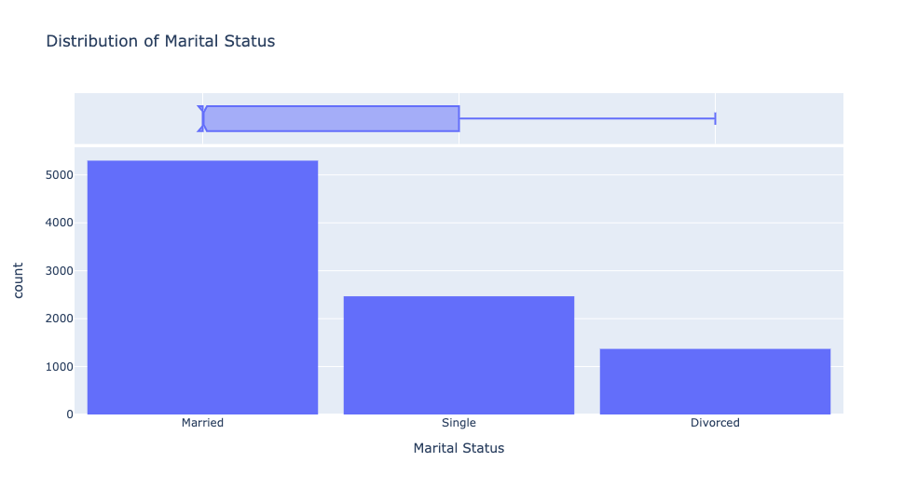
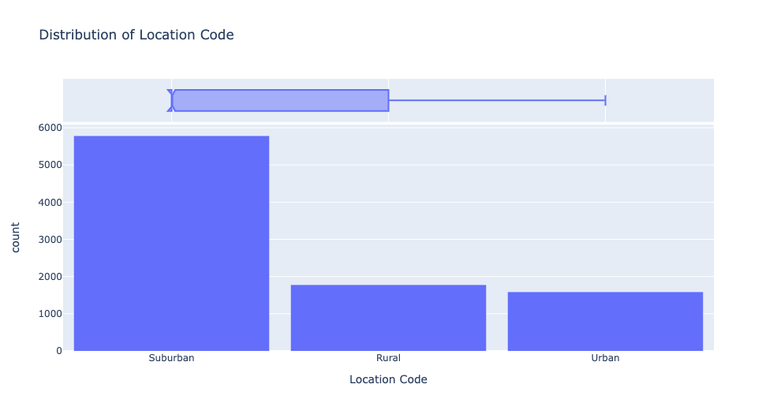
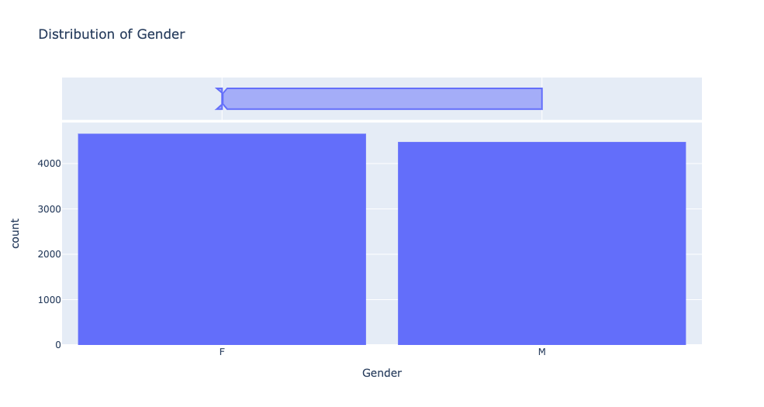
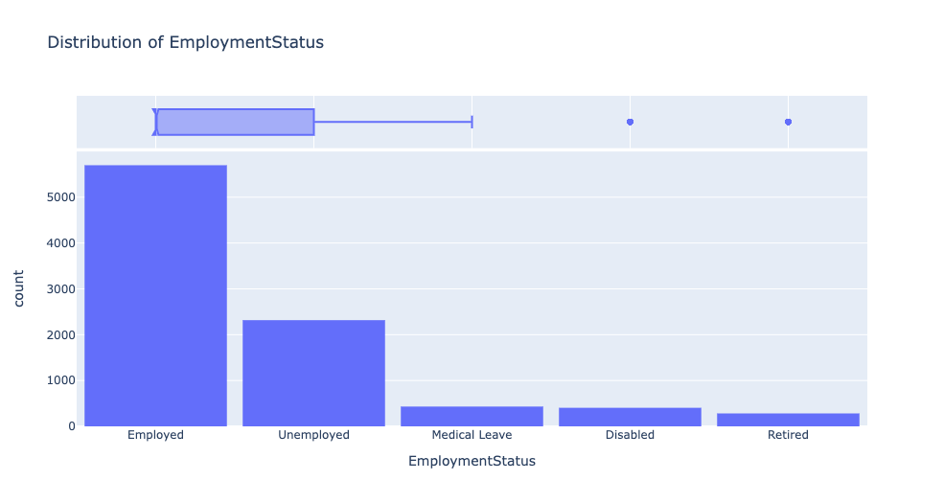
Notes:
We can see that some features have very distinct distributions and some of them are very similar.

Slide 10
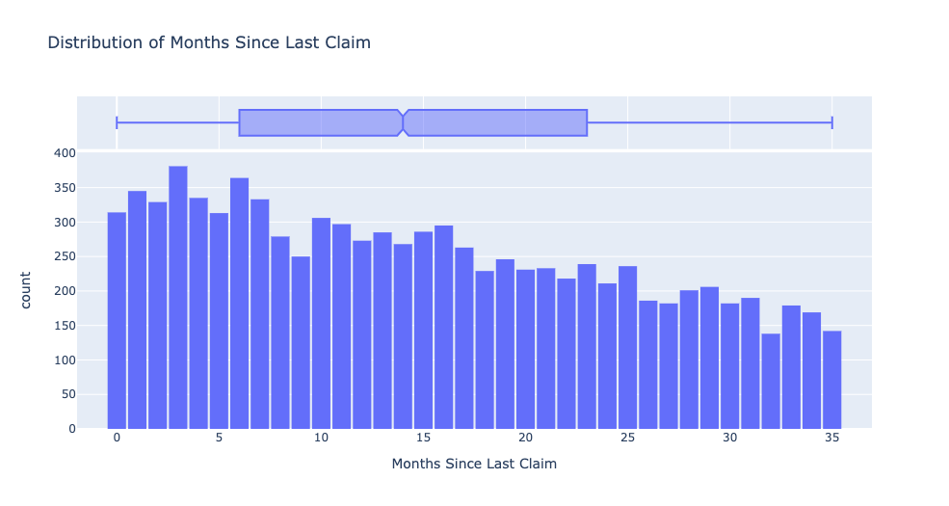
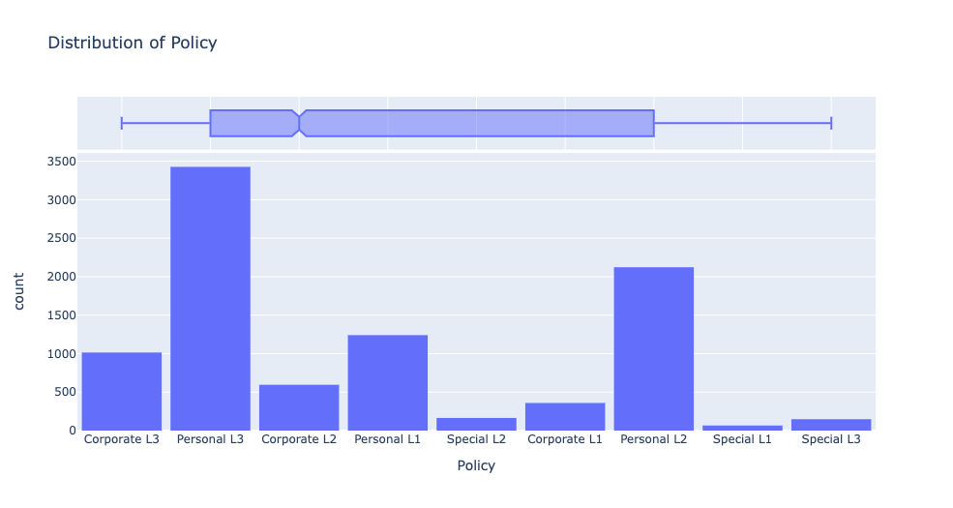
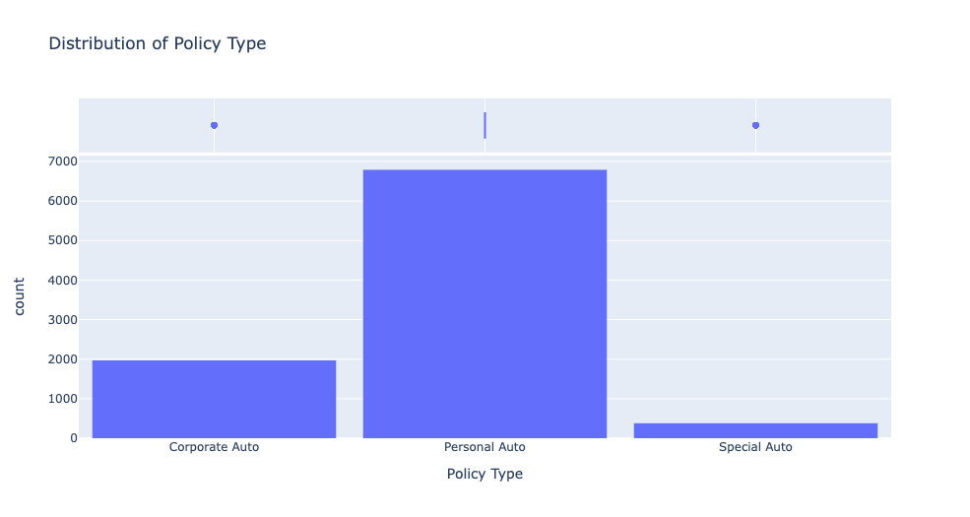
Notes:
This can help us form the hypothesis about the correlations that we’ll explore later.

Slide 11
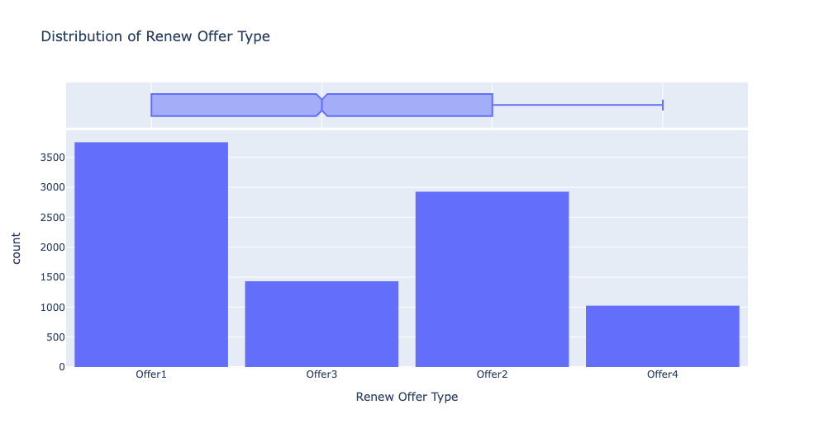
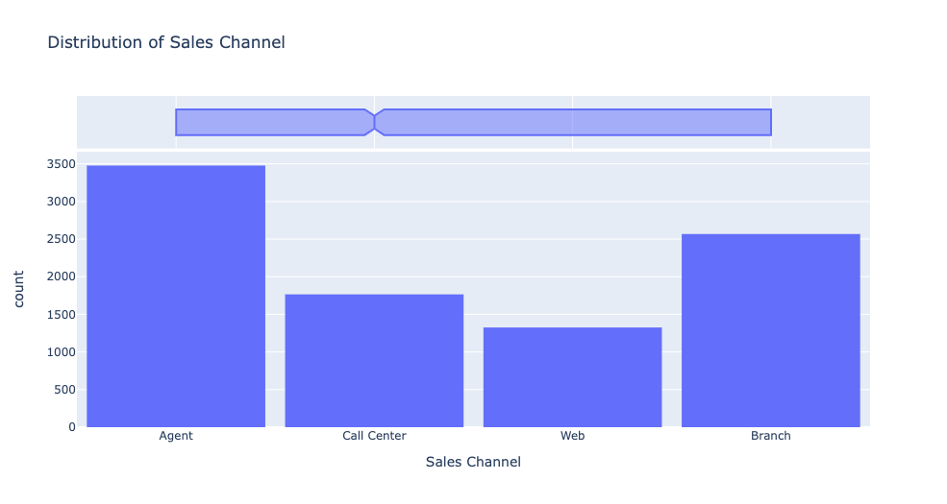
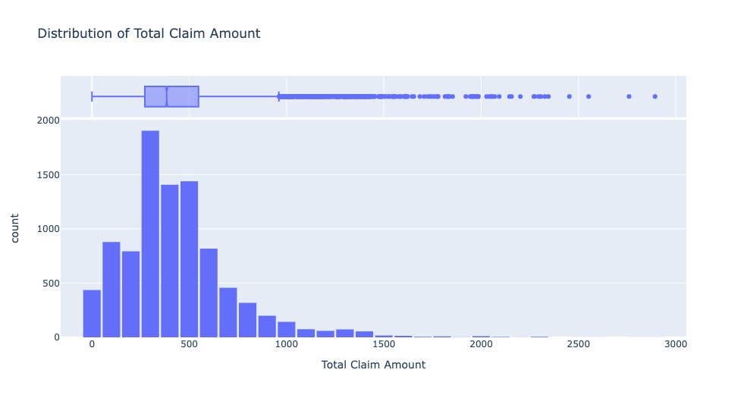
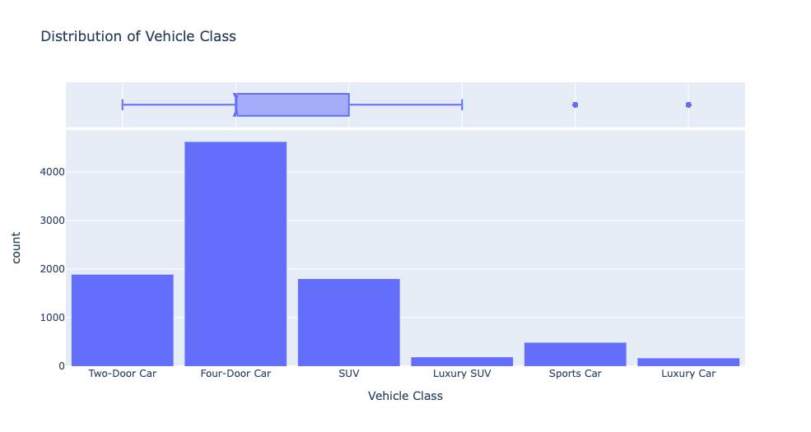
Notes:
And also, the distribution plots can help us recognize outliers among the data and thus help us better clean the data.

Slide 12
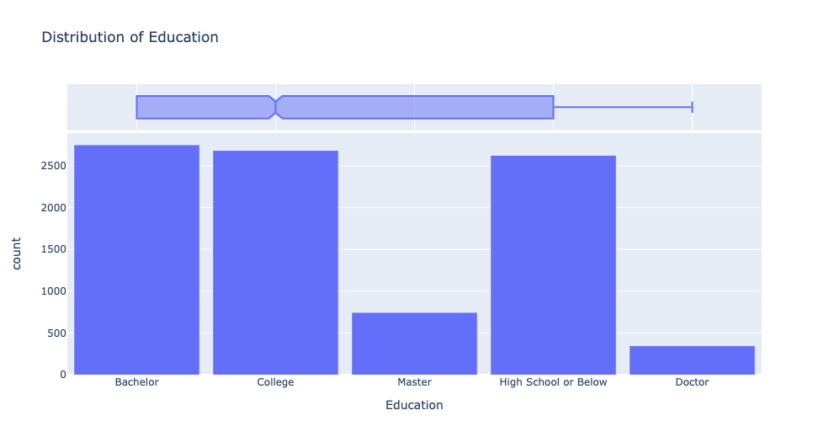
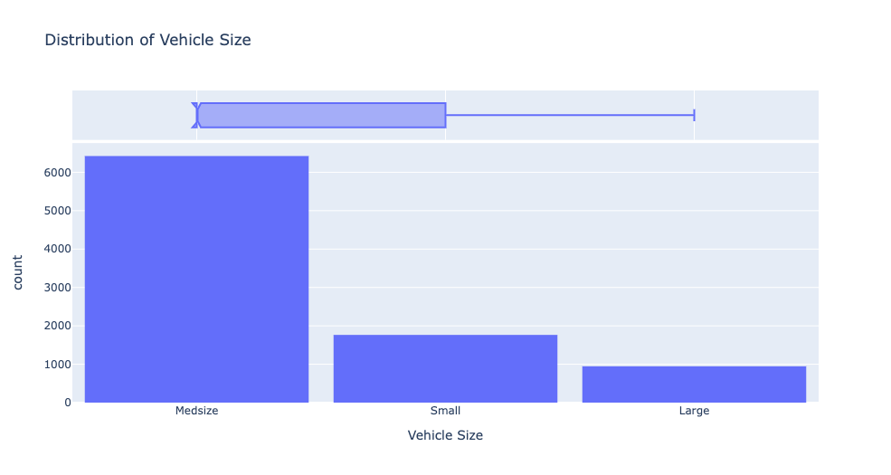

Slide 13
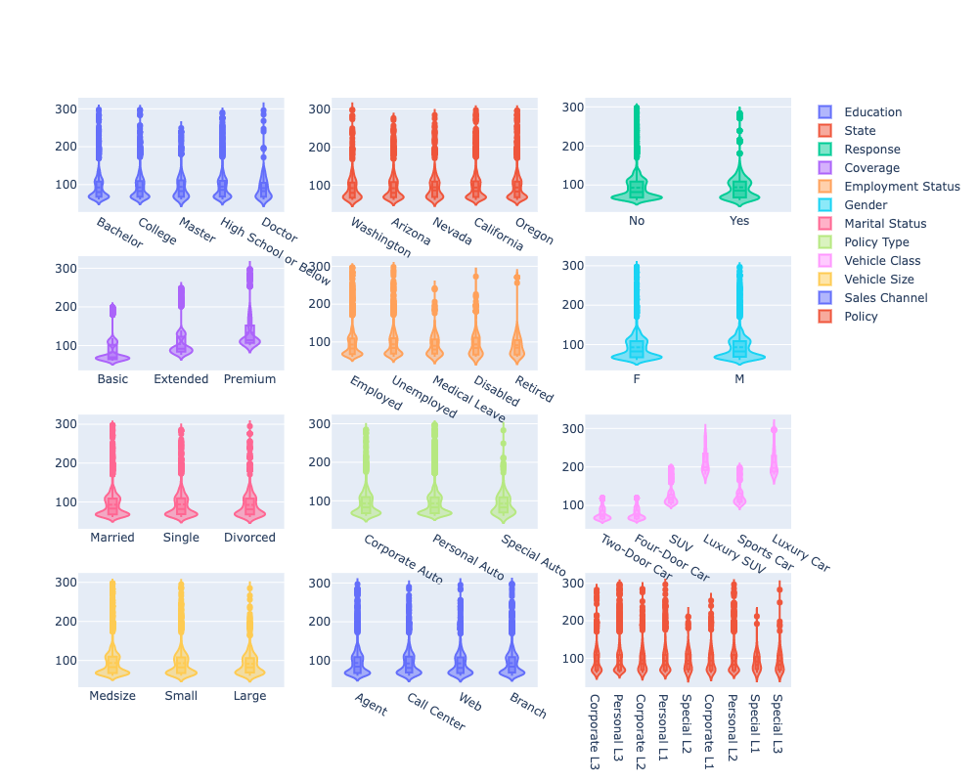
Relationship to Monthly Premium
Notes:
Then we move onto exploring the relationship between features and the monthly premium that we are trying to model at the end. These are the violin plots that we did for categorical features. From these plots we can see that the coverage plans and the vehicle class have a relatively strong relationship to the monthly premium. It makes sense because a better coverage has a higher price and luxury cars usually have higher insurance price.

Slide 14
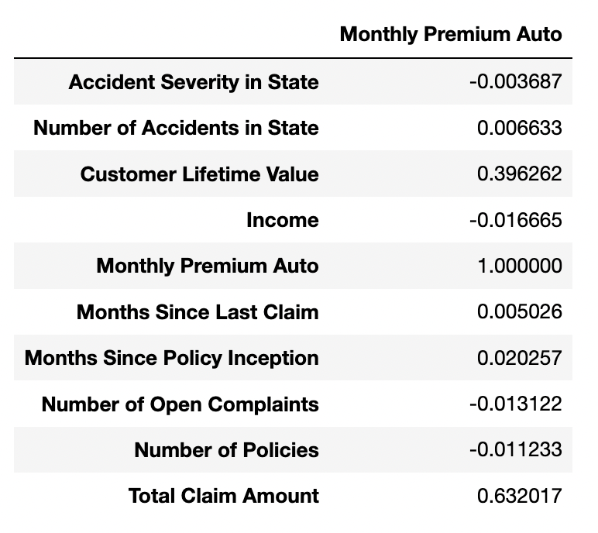
CORRELATION ANALYSIS - Numerical Features
Notes:
This correlation table containing all the numerical features tells us that customer lifetime value and total claim amount have relatively strong relationships to the monthly premium. It also makes sense because the higher the claim amount is, the higher the risk is involved with this customer.

Slide 15
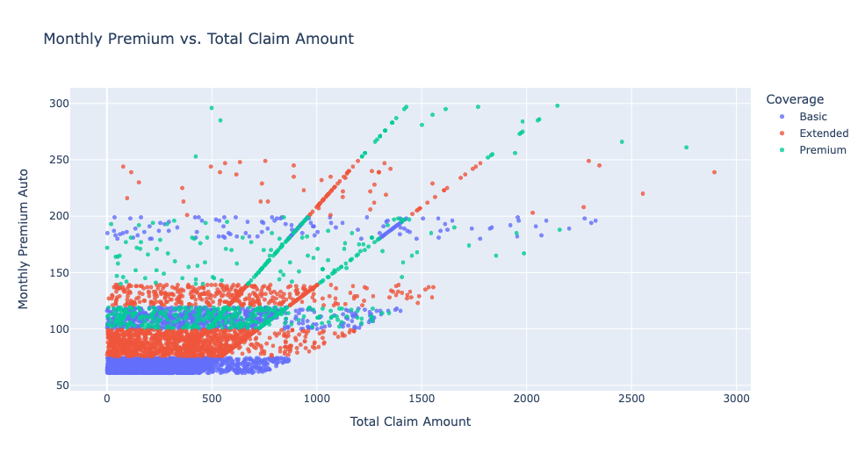
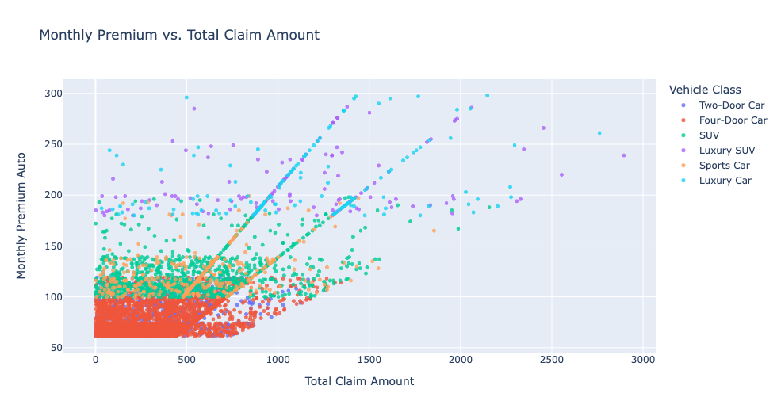
Monthly Premium to Total Claim Amount
Notes:
So knowing that, we dive into details regarding those features. Here in these scatter plots, we have contained the total claim amount and monthly premium as well as coverage plans and vehicle class indicated by different colors. For example, in these two plots, we can see that below 500 of claim amount, it doesn’t have a strong influence on the premium, however going above 500, there is a strong positive correlation between them.

Slide 16
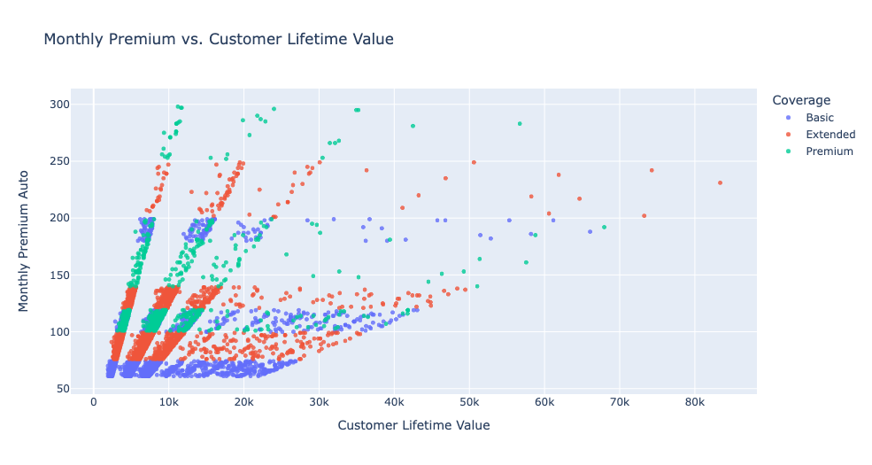
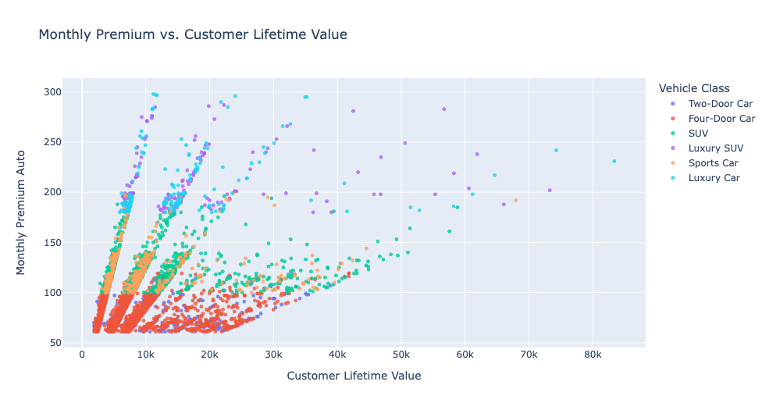
Monthly Premium to Customer Lifetime Value
Notes:
Similarly, we plotted the premium with customer lifetime value and recognize a even stronger relationship between them.

Slide 17
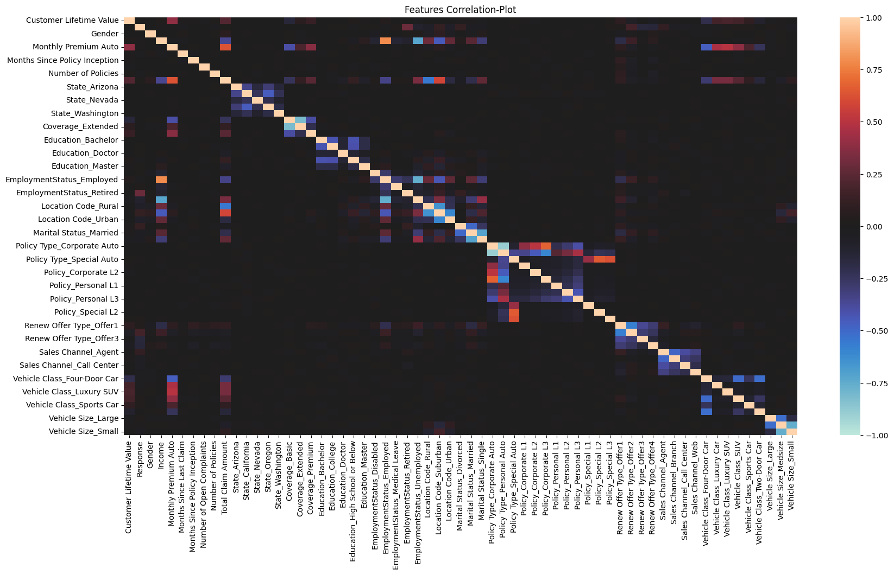
Features Correlation Heatmap
Notes:
Finally in this section, we’ll present a heatmap of correlations among every single feature after one-hot encoding.

Slide 18

Pricing Strategy - Coverage Classification
03
Notes:
Those are the EDA we conducted, let’s move onto the first part of our pricing strategy - coverage classification

Slide 19
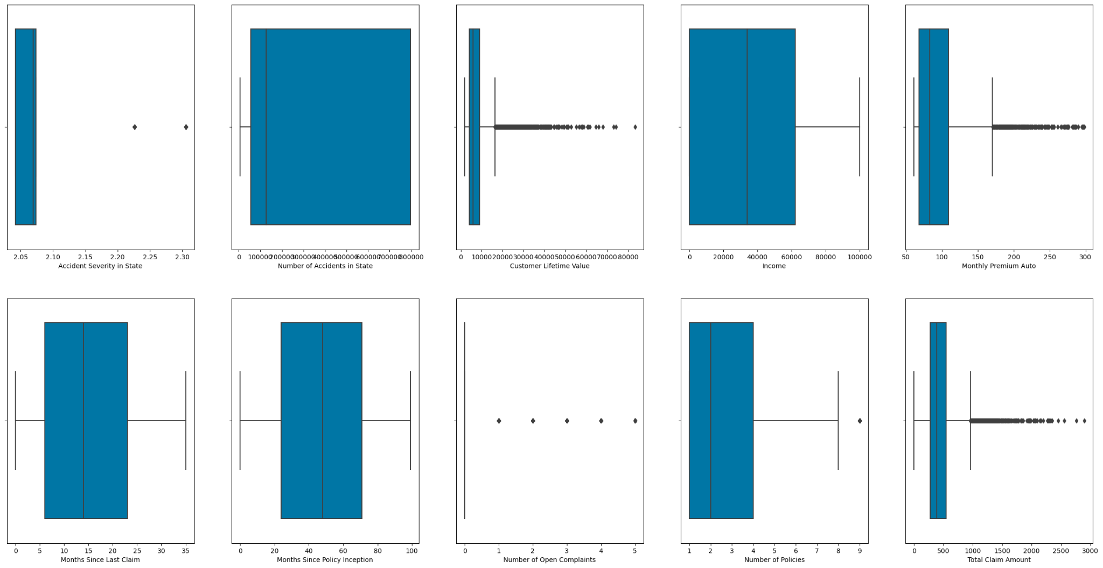
‘Outliers’ in the data
Notes:
Our analysis for the classification starts from the potential unbalanced data problem. When we do the eda for classification, we found that the outliers here should not be eliminated since they may represented a unbalanced class.

Slide 20
Are they really outliers?
Accident Severity in State
number of outliers: 1680
percentage of outliers: 0.1839281804247865
*********************************************
Customer Lifetime Value
number of outliers: 817
percentage of outliers: 0.08944602583753011
*********************************************
Monthly Premium Auto
number of outliers: 430
percentage of outliers: 0.047076855703963215
*********************************************
Number of Open Complaints
number of outliers: 1882
percentage of outliers: 0.20604335449967157
*********************************************
Number of Policies
number of outliers: 416
percentage of outliers: 0.04554412086708999
*********************************************
Total Claim Amount
number of outliers: 453
percentage of outliers: 0.04959492007882636
*********************************************
Notes:
If you look at the data and use the standard in boxplot to identify outliers, you would find the percentage of them are well above what we generally consider as outliers. And this would be indicated in the following visualization.

Slide 21
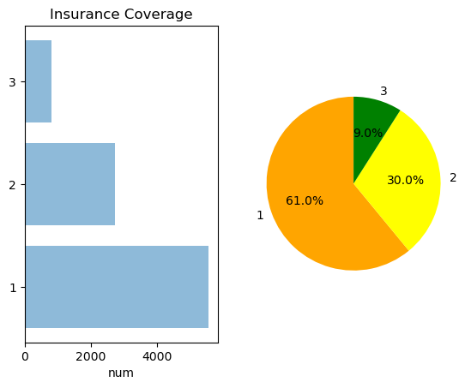
EDA for classification
Basic
Extend
Premium
From the distribution pie chart, it’s clear that we may have a unbalanced data problem, especially for premium customer group.
Notes:
When we visualize the classification of the insurance coverage, we will find most of people will purchase the basic plan, and a third of customers will be in extended program, but only less than 10% of people are purchasing premium. In machine learning model construction we typically consider it as a extreme unbalanced data problem.

Slide 22
Necessity to deal with unbalance
Comparison of the confusion matrix
 | Basic | Extend | Premium
Basic | 1632 | 40 | 0
Extend | 293 | 524 | 11
Premium | 0 | 182 | 59
 | Basic | Extend | Premium
Basic | 97.61% | 2.39% | 0.00%
Extend | 35.39% | 63.29% | 1.33%
Premium | 0.00% | 75.52% | 24.48%
Notes:
The classification result from logistic regression also proves such issue: for basic and extend program, most users can be correctly classified but for premium, over 3 quarters of people are misclassified to extend program.

Slide 23
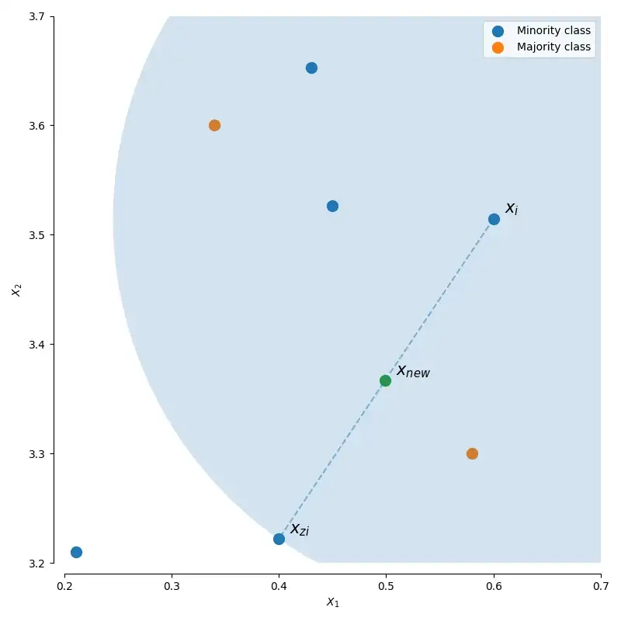
Solution for the Imbalanced Data
SMOTE: Synthetic Minority Over-sampling Technique
Basic Idea: generate similar data points with the record in the unrepresented class
SMOTE-NC: Synthetic Minority Over-sampling Technique for nominal and continuous features
Key difference: Can deal with the categorical data (by selecting the nearest record)
Notes:
To deal with this problem, we utilized SMOTE-NC, which are generating mode data points for the underrepresented class artificially. As you can see the green point is manually created based on other two data points from such underrepresented class.

Slide 24
Improvement on LR
 | Basic | Extend | Premium
Basic | 1626 | 46 | 1
Extend | 214 | 559 | 41
Premium | 0 | 65 | 189
 | Basic | Extend | Premium
Basic | 97.19% | 2.75% | 0.06%
Extend | 26.29% | 68.67% | 5.04%
Premium | 0.00% | 25.59% | 74.41%
From 80.8% to 86.6%
Notes:
With this technique, the model accuracy was improved considerably, especially for the premium class: now that around 75% of premium users are classified correctly, and the overall accuracy was promoted from 80.8% to 86.6%. Now we will enter the next part, pricing strategy.

Slide 25

Pricing Strategy - Customer Lifetime Value
04

Slide 26
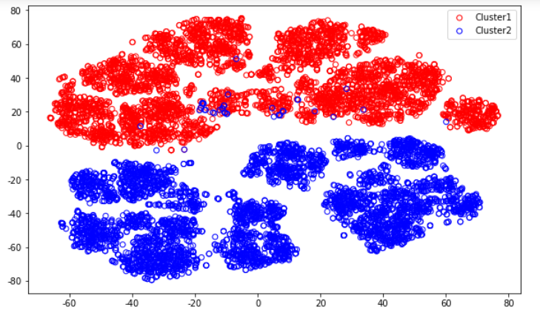
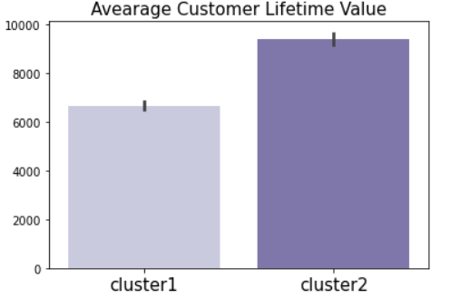
Cluster Customers based on Customer Lifetime Value
the total worth to a business of a customer over the whole period of their relationship
Notes:
Now we move on to customer lifetime value. it is very important for the company to know and to be able to predict this value so that they can target on the right type of customers that generate the most profit. to help the company do this, we first build a classification model to cluster customers into different groups with respect to customer lifetime value. As shown in the graph, we clustered them into 2 groups. And we could see that cluster2 has a higher customer lifetime value.

Slide 27
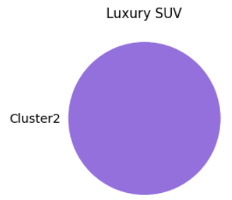
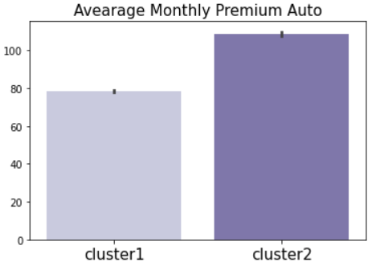
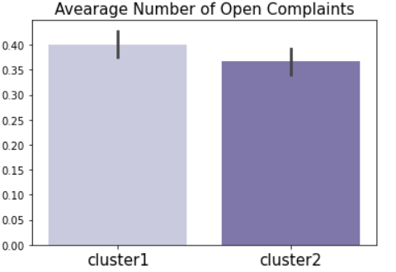
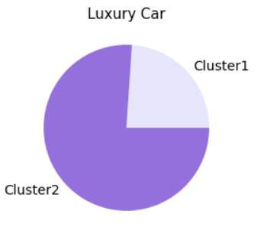
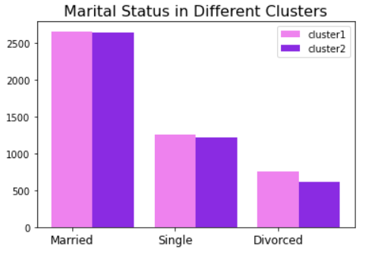
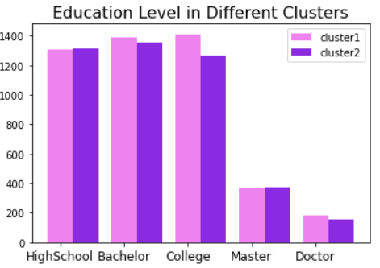
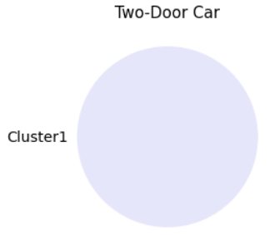
Cluster Customers based on Customer Lifetime Value
Notes:
now we try to do some data analytic to get the characteristics of different groups. we want to look into three aspects. the first aspect is insurance itself, which is indicated in the top bar charts, including monthly premium and number of open complaints. The second aspects concerns personal features such as marital status and education level. The third aspects is the car type. Through these visualizations, we could see that cluster2 has a higher premium paid, and lower complaints. cluster2 also has a more stable marrital status and higher education level. Besides, they also tend to have more expensive cars. So, wrapping up those results, company can really use them to classify new customers into the corresponding group so as to come up with better marketing strategies for them

Slide 28
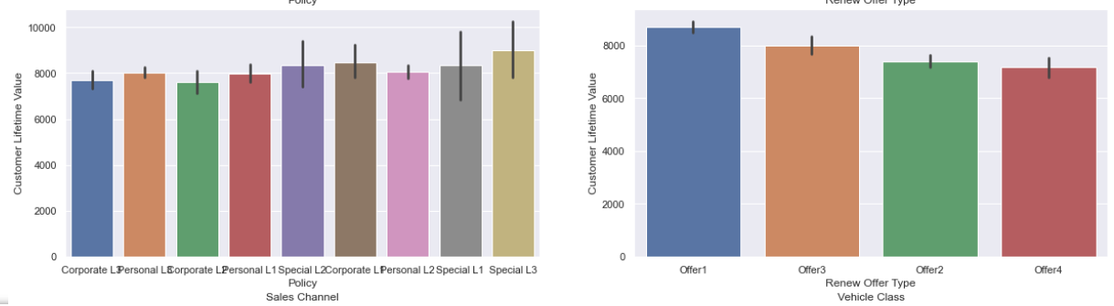
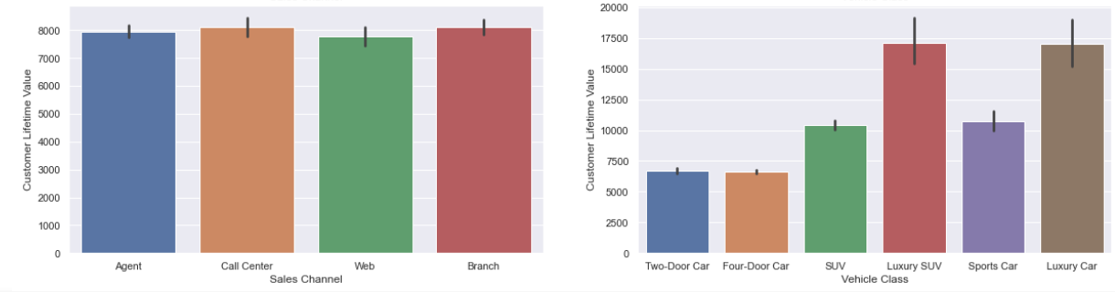
Processes of Lifetime Value Modeling
Use barplot and boxplot to get basic distribution of some factors and make some filtration.
Notes:
In the process of Lifetime Value Modeling , We firstly find the significant factors for predicting lifetime value through drawing barplot and boxplot, if lifetime value have significant different distribution for some factor, then we think it matters in the value predict process.

Slide 29
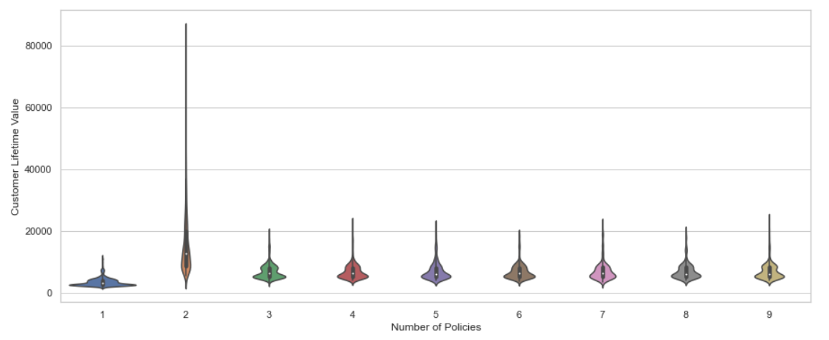
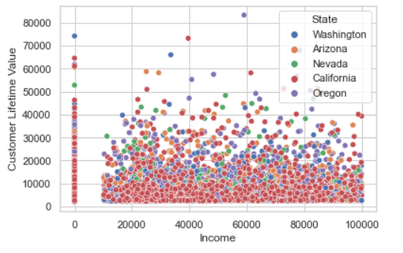
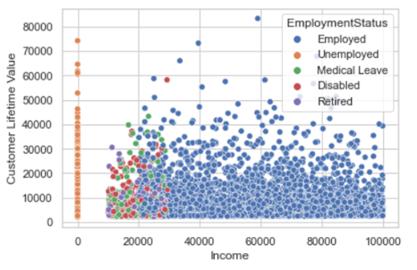
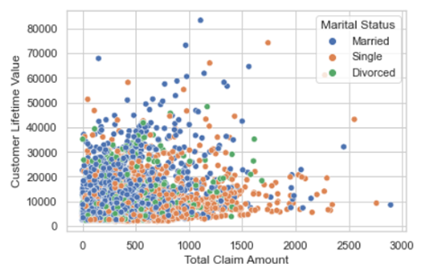
Use violin plot to get classification of policy numbers
The belows are significant factors, and we use scatter plot to show them.
Notes:
Then, We use some specific analyse to deal with some factors, we find that when the number of policies equals to 2, it is different with when it is larger than 3, and we find that income, Employment Status, Marital Status are important factors, this can be shown with the scatter plot.

Slide 30
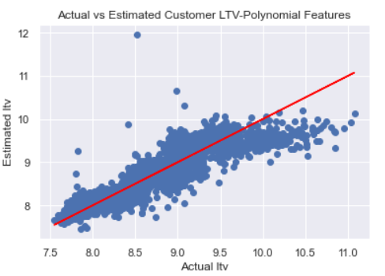
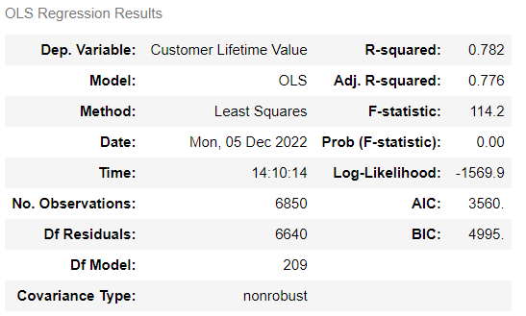
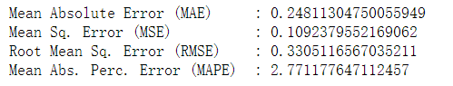
Build the OLS model, get the result, and do some analysis.
Notes:
Thirdly, We build the OLS model to predict. The result looks not bad. Our R-squared shows that our ols model could explain more than 75% of the customer life value. And what’s more, the MSE is 0.109, which looks pretty good. We actually did some variables interpretations, but because of the limitation of time, I have to skip them.

Slide 31

05
Pricing Strategy - Monthly Auto Premium
Notes:
Alright, now we’re heading to the final part of our strategy which is monthly premium predicting.

Slide 32
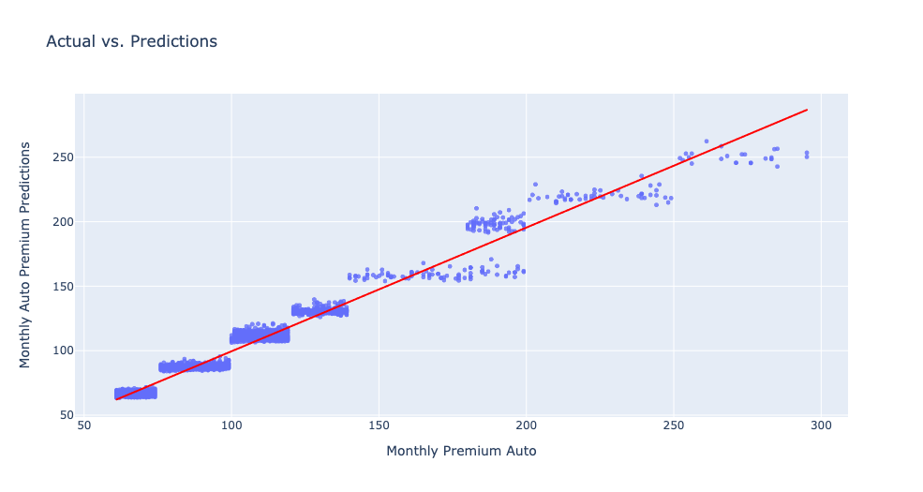
Preliminary Modeling Results
Notes:
In this part, we also employed the machine learning tools and built a model to predict monthly premium. Since we have not completed the final consolidation of our model, we’ll present a preliminary results here and will include more details in the report.

Slide 33

06
Conclusion and Future Perspectives

Slide 34
WE HAVE DONE
Coverage
Customer Lifetime Value
Monthly Auto Premium
Predictive Machine Learning Modeling and Clustering
Machine Learning Modeling
Classification
Notes:
So what we have done so far? We have done a coverage classification modeling, customer lifetime value predicting, and a monthly auto premium predicting.

Slide 35
Future Perspectives
Dig into the hidden information behind our Exploratory Data Analysis
Improve the accuracy of our monthly premium ML model
Conduct more evaluation analysis on our models including sensitivity and scenario analysis
Involve in the concept of revenue management and build a more comprehensive pricing strategy
Notes:
Here are some of our future perspectives for this project. Because of limitation of time, we’re not going to go through each and every one of them. We’re now open to any questions you have. Thanks!

